Slide 1


Good Morning!
Student Performance Monitoring System
Group 27
Team Data Armour

Slide 2

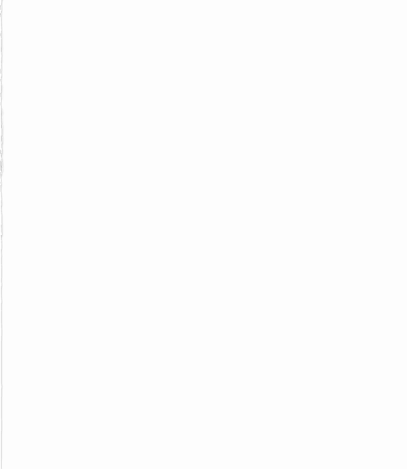
Team Members
Md. Tuhin Al Jobayer 1831124
Farsheed Rahman 1830360
S.M Arif Mahmud 1830398
Safayet Khan 1820080
Sheikh Raiyan Hossain 2021937
Md Samiur Rahman 1930661
Group 27
Team Data Armour

Slide 3
Background
Our project's goal is to create, develop, and distribute software that, in our opinion, will assist universities worldwide in promoting a more fruitful and efficient method of student evaluation.
We've introduced the notion of Course Outcomes (COs) and Program Learning Outcomes (PLOs), where each CO is mapped to a PLO, and each PLO represents a particular valuable skill that students are expected to acquire or improve at the conclusion of that course.
The project will determine whether each student has successfully completed the PLOs that are linked to the COs requirements in order to evaluate them effectively through tools such as spider charts.
Students can monitor their progress in each area and identify their areas for growth and improvement. Our program also aims to help the institutional bodies, including faculty, administrative, and departmental bodies, track student development, departmental performance, and better distribute and allocate resources.

Slide 4
Objectives And Scope
Our project aims to develop an interactive, user-friendly program that will serve as a platform for university staff, faculty, and other participants to assist in enhancing the standard of instruction and revolutionizing how we incorporate technology into our education.
Our approach entails building a Web application called SPMS 2 that makes use of a Relational Database Management System (RDMS) to store, edit, add, and update the data required for tracking student performance as well as for producing and archiving related OBE data, reports, and documents
We created hypothetical users for the web based SPMS system and made assumptions about their usage patterns and the information and data they would require
We will create unique user interfaces and login options for various stakeholders who will also be using this system.
We develop user interfaces that allow all users to quickly access relevant files, tabular data and reports and the use of RDMS offers real time interaction with the relevant data.
We create a platform through which faculties may work together to create course outline, course reports, mark sheets, assessments, map assessments to COs and PLOs for PLO successes, and keep track of student evaluations for all their courses throughout the semester and upload questions in the question bank for the students

Slide 5
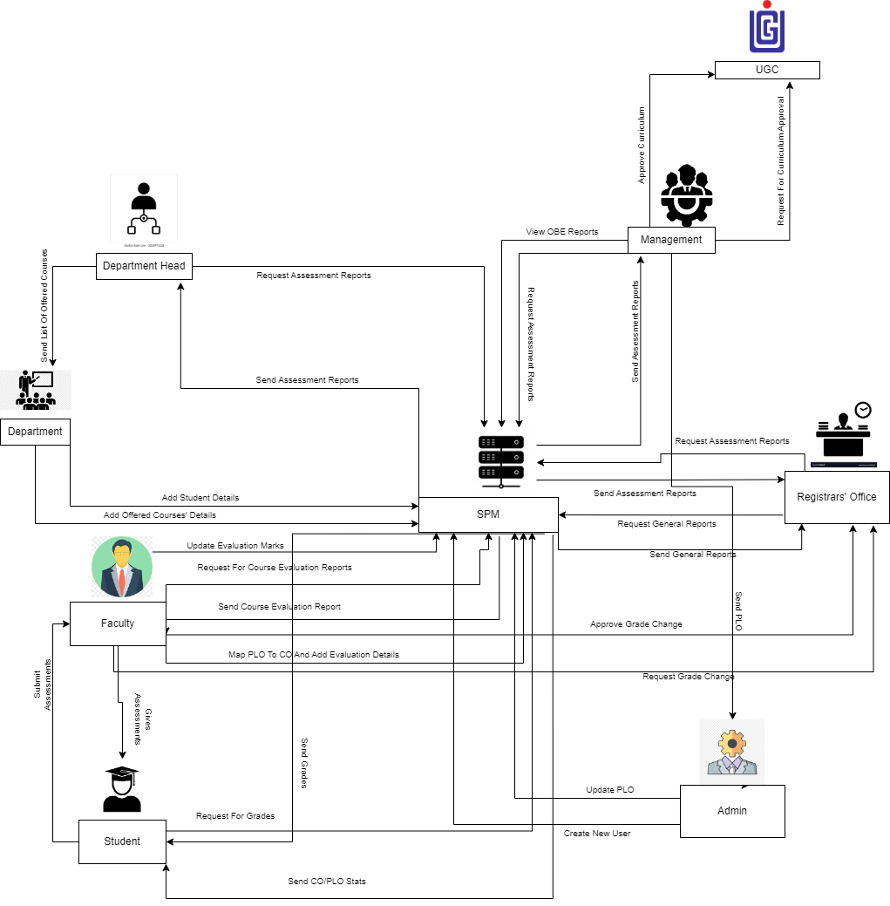
Rich Picture Existing System

Slide 6
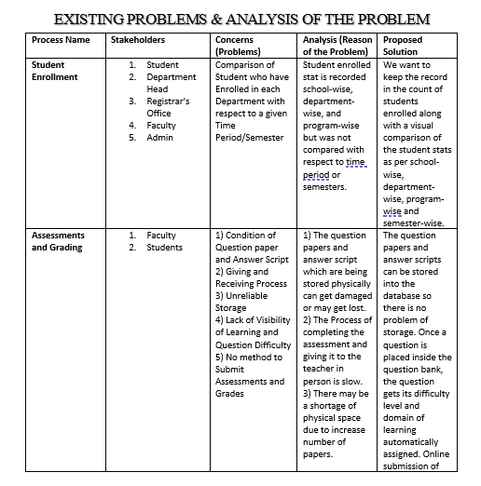
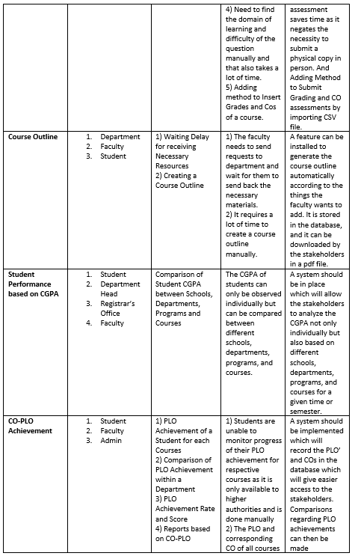
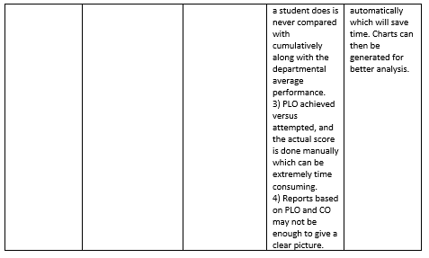
Problem Analysis

Slide 7
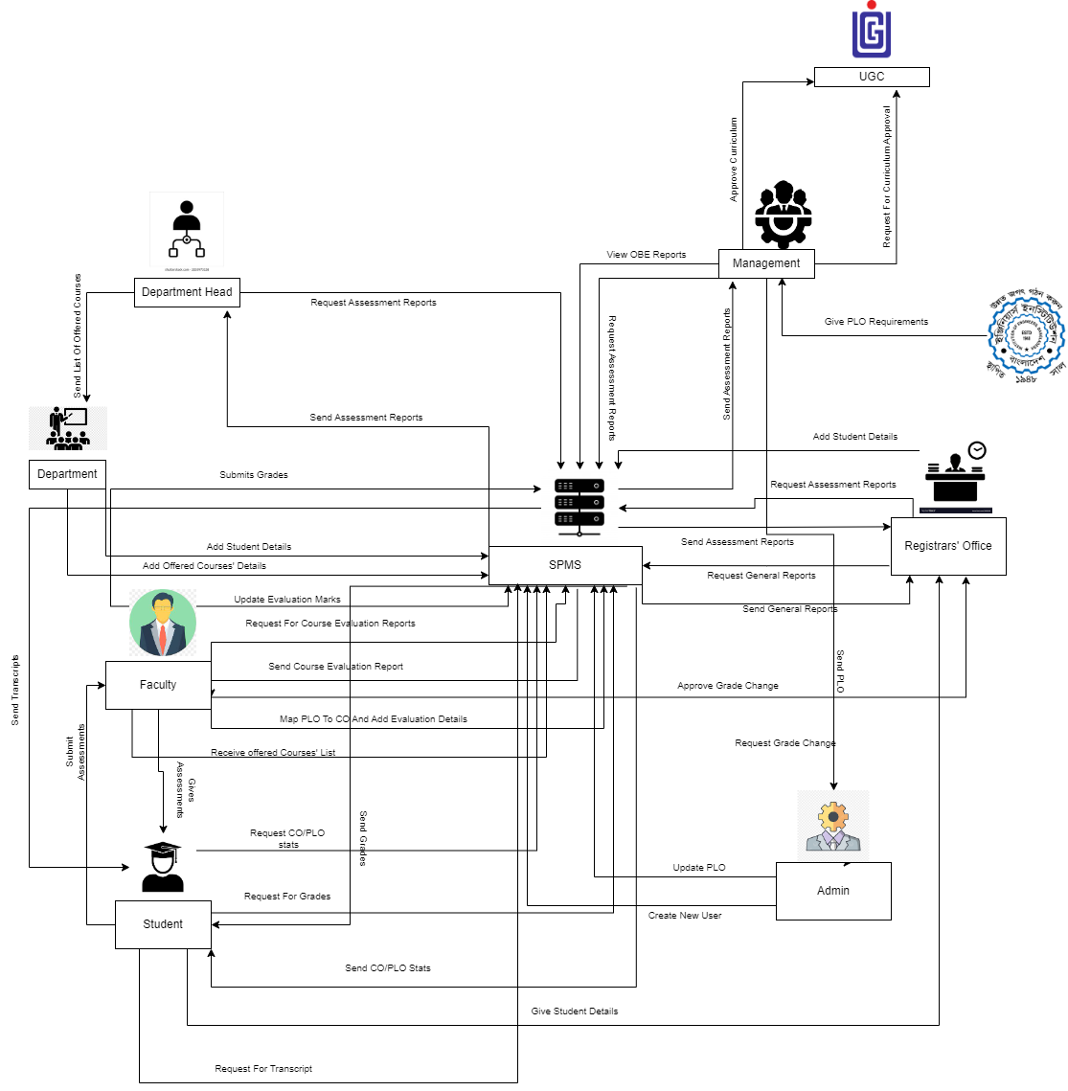
Rich Picture TO BE

Slide 8
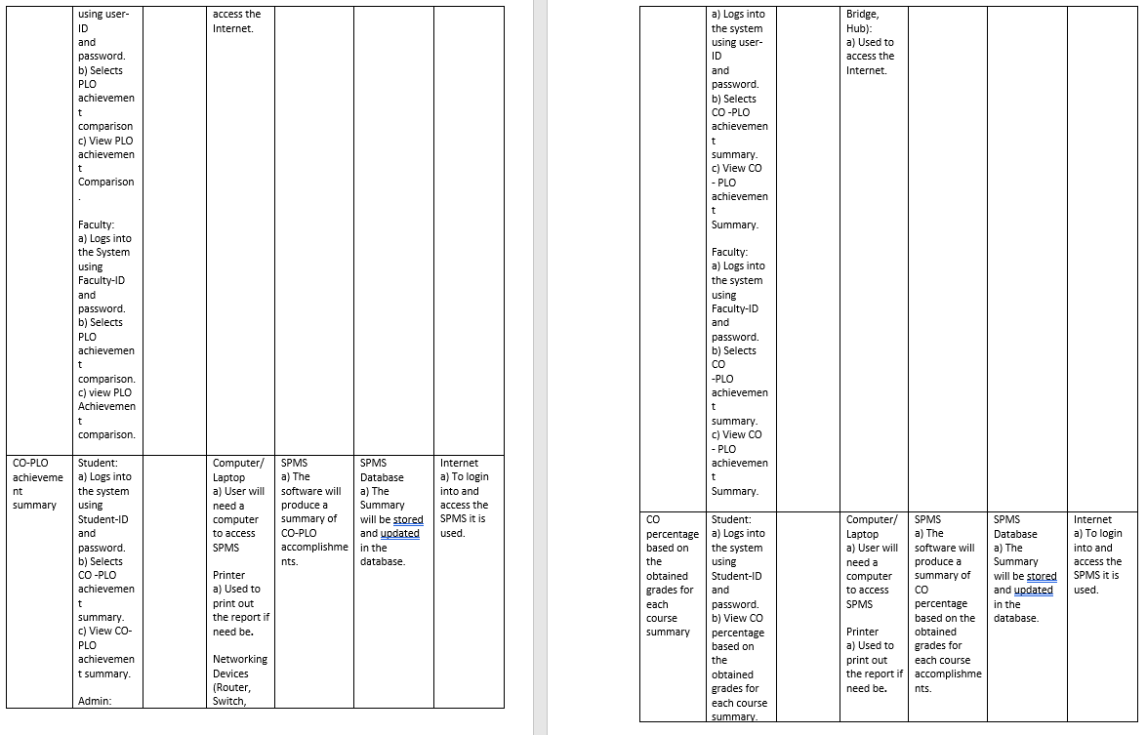
Six Elements Analysis TO BE

Slide 9
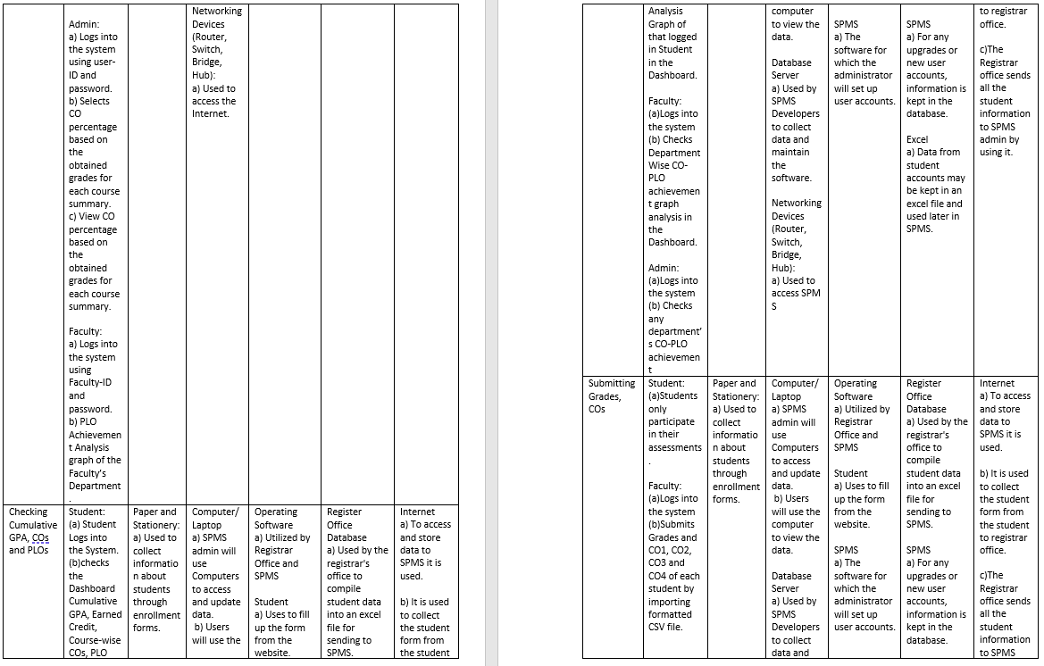
Six Elements Analysis (continued)

Slide 10
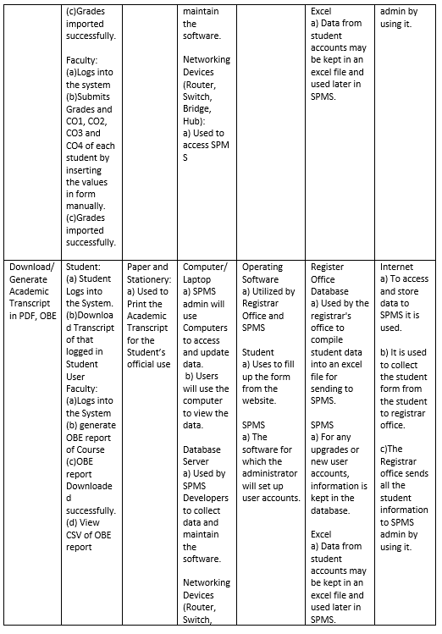
Six Elements Analysis (continued)

Slide 11
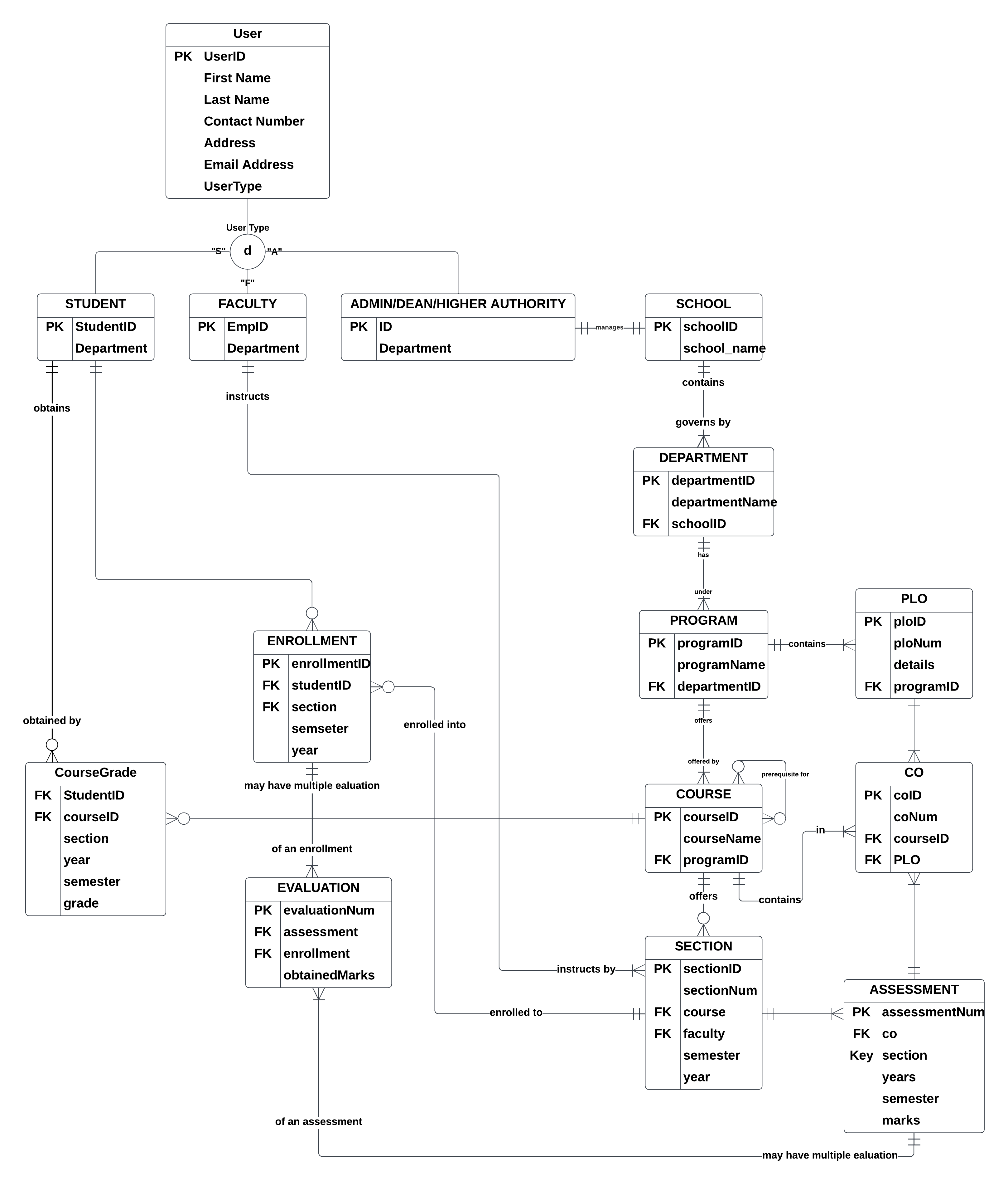
Entity Relationship Diagram

Slide 12
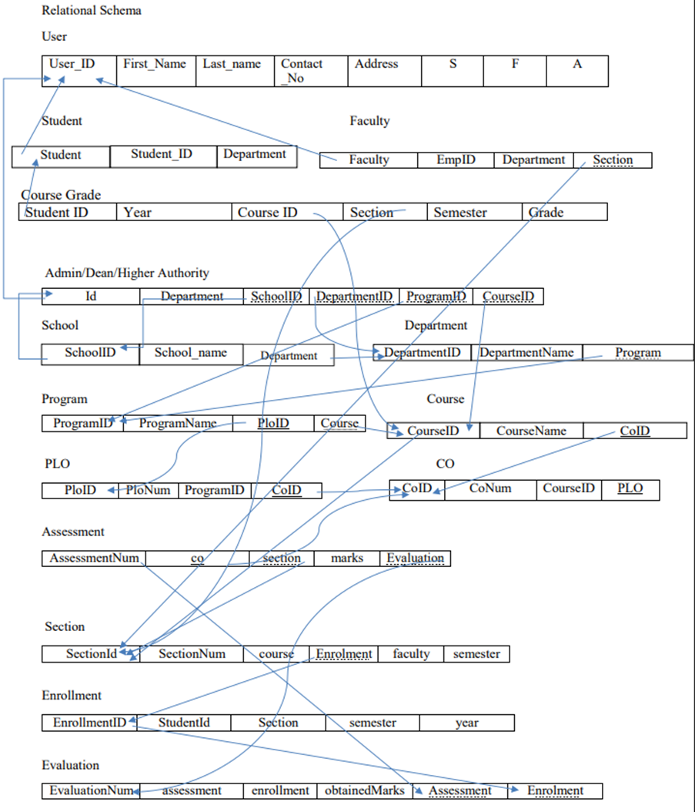
Relational Schema

Slide 13
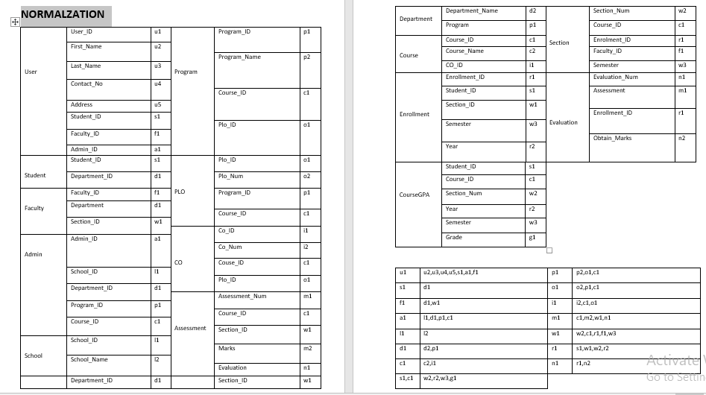
Normalization

Slide 14
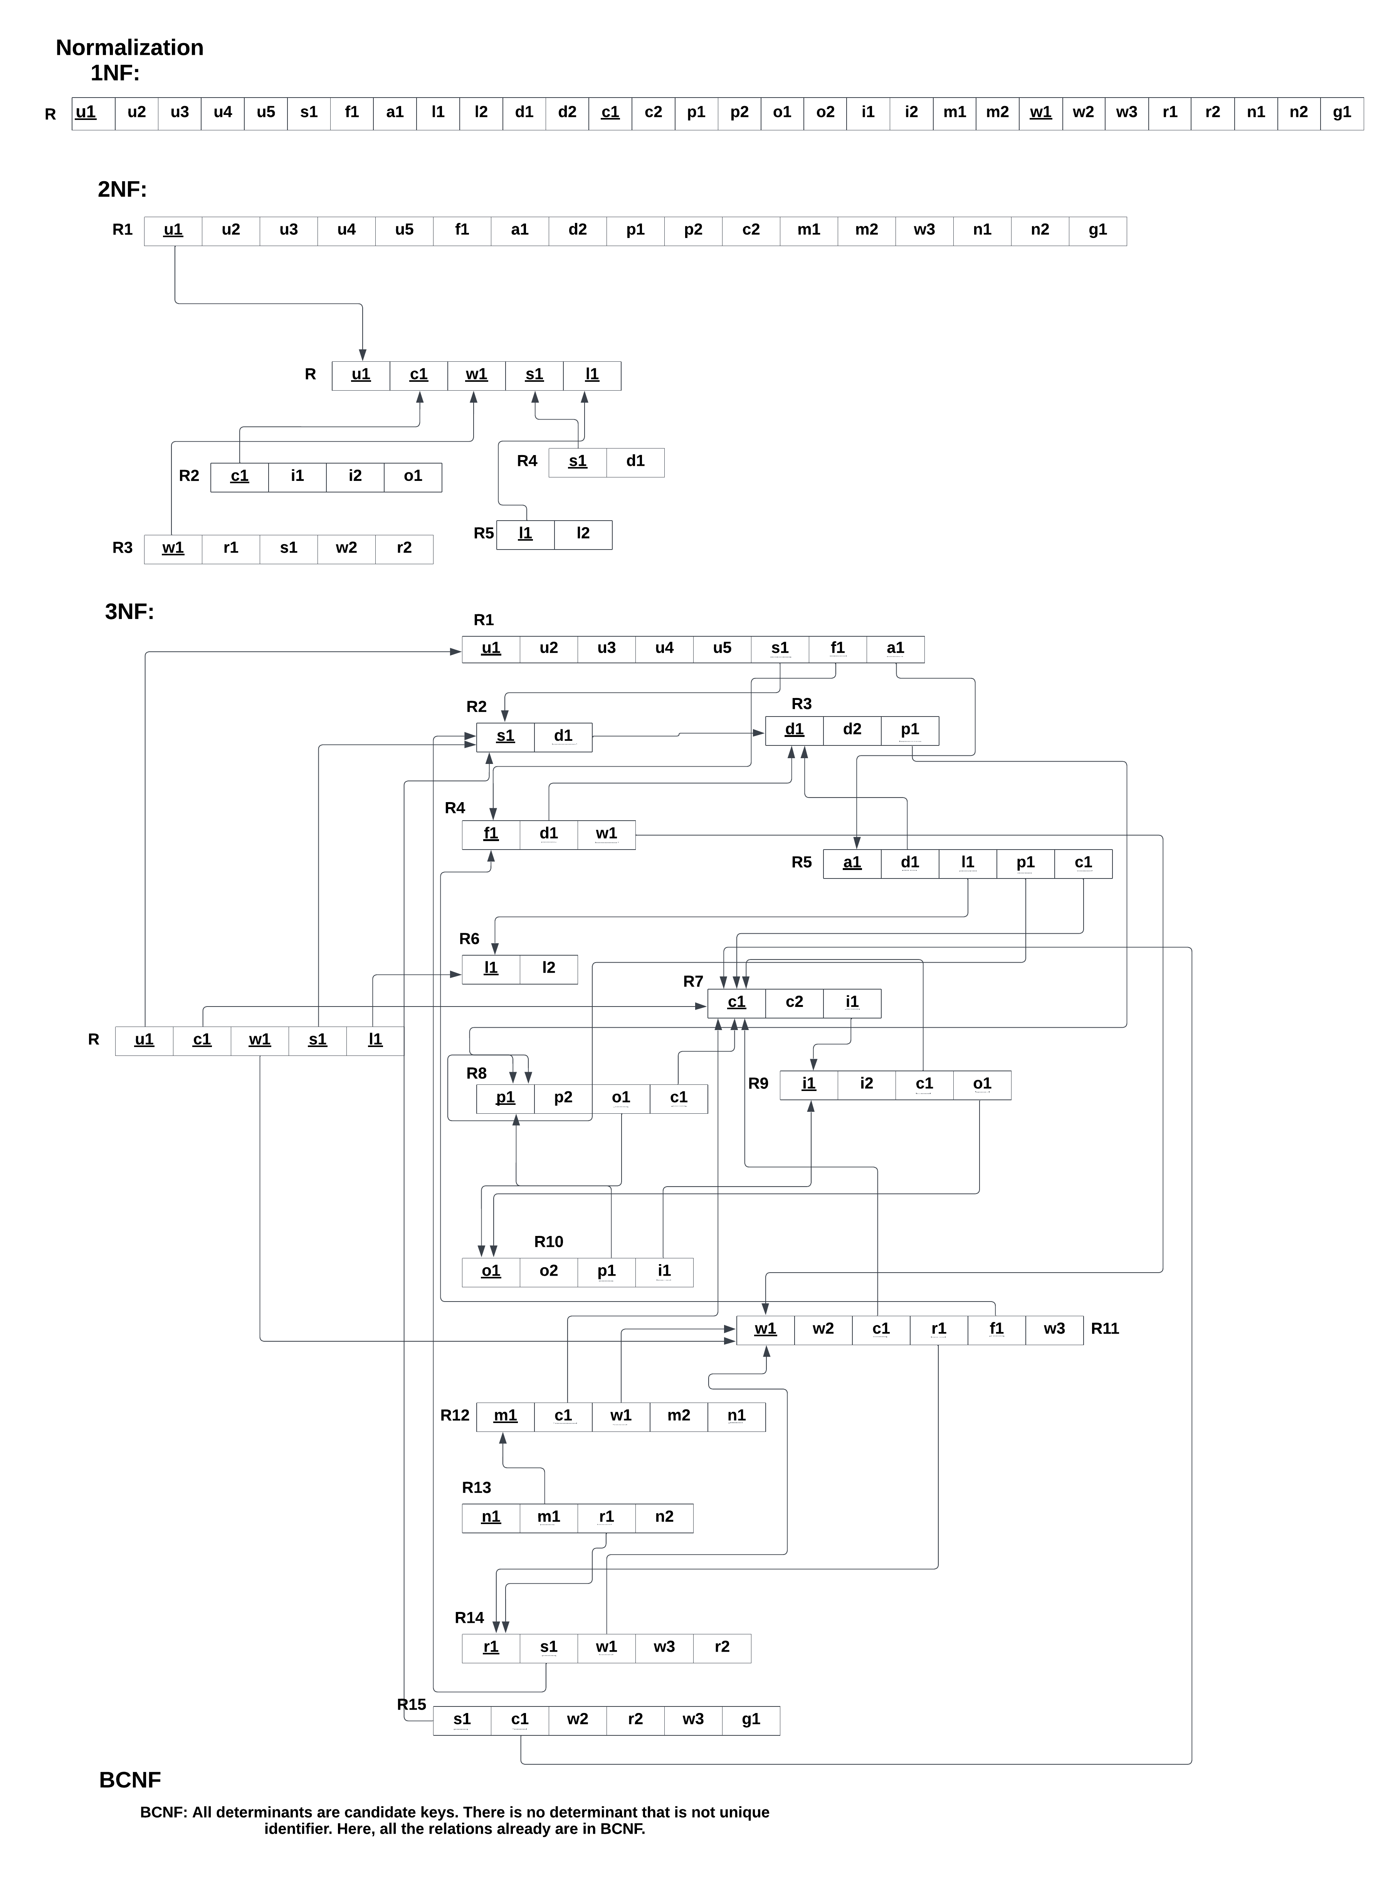
Normalization (continued)

Slide 15
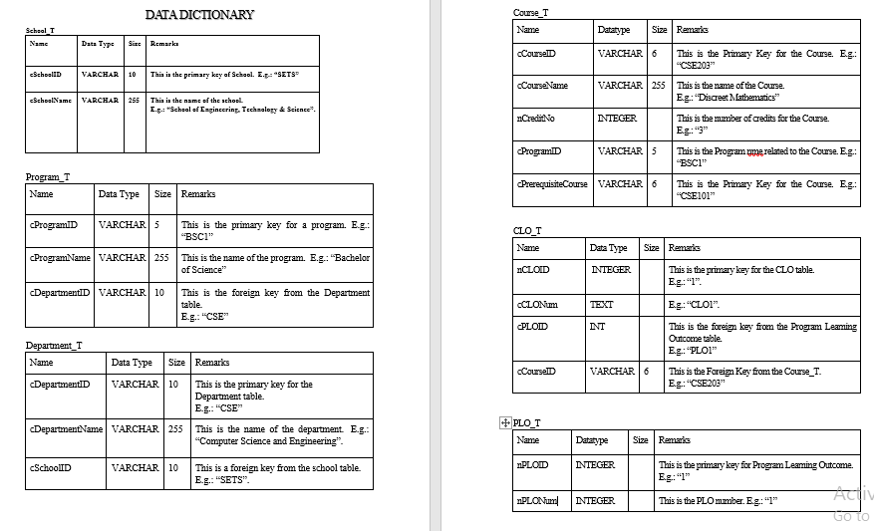
Data Dictionary

Slide 16
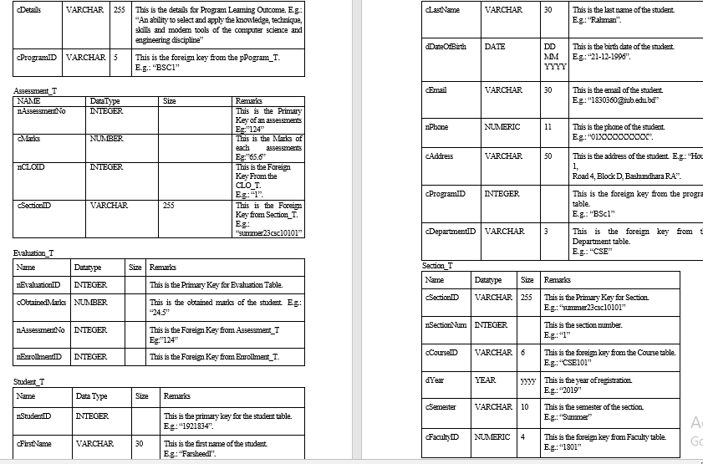
Data Dictionary (continued)

Slide 17
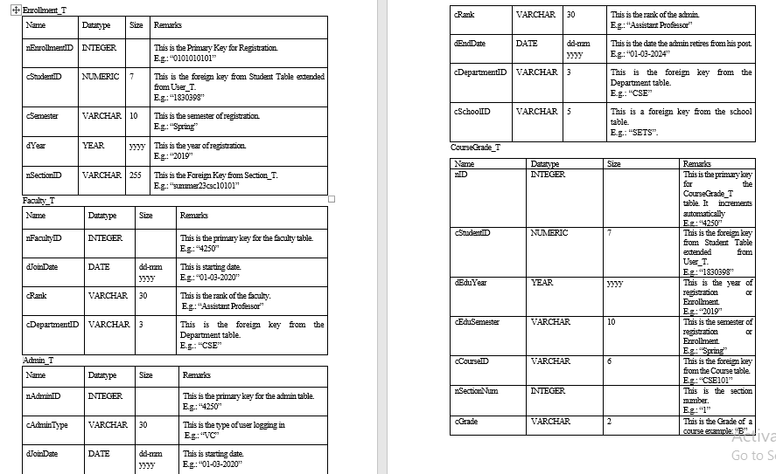
Data Dictionary (continued)

Slide 18
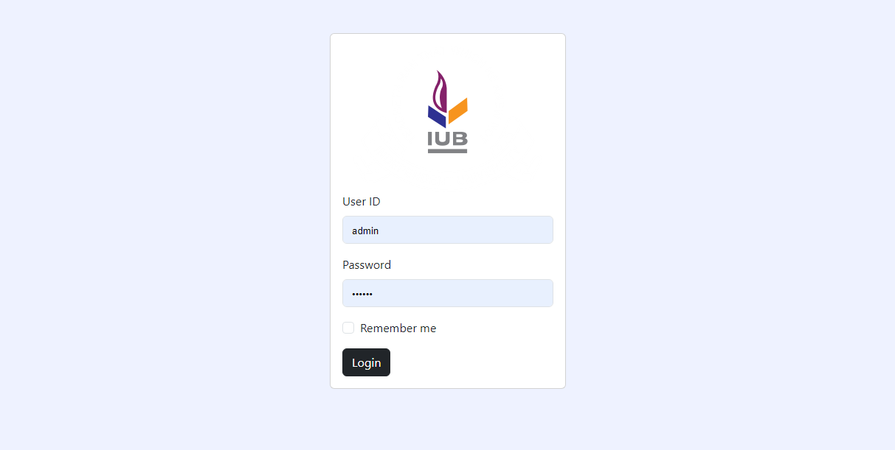
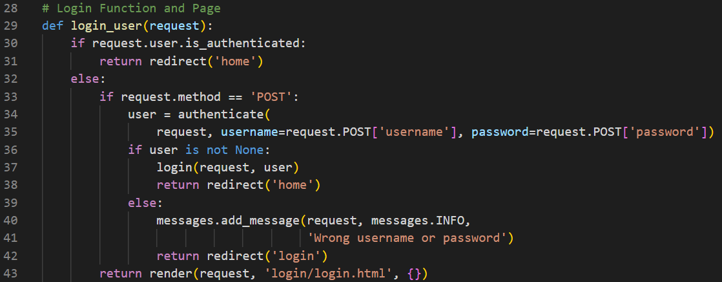
Physical System Design (Login)

Slide 19
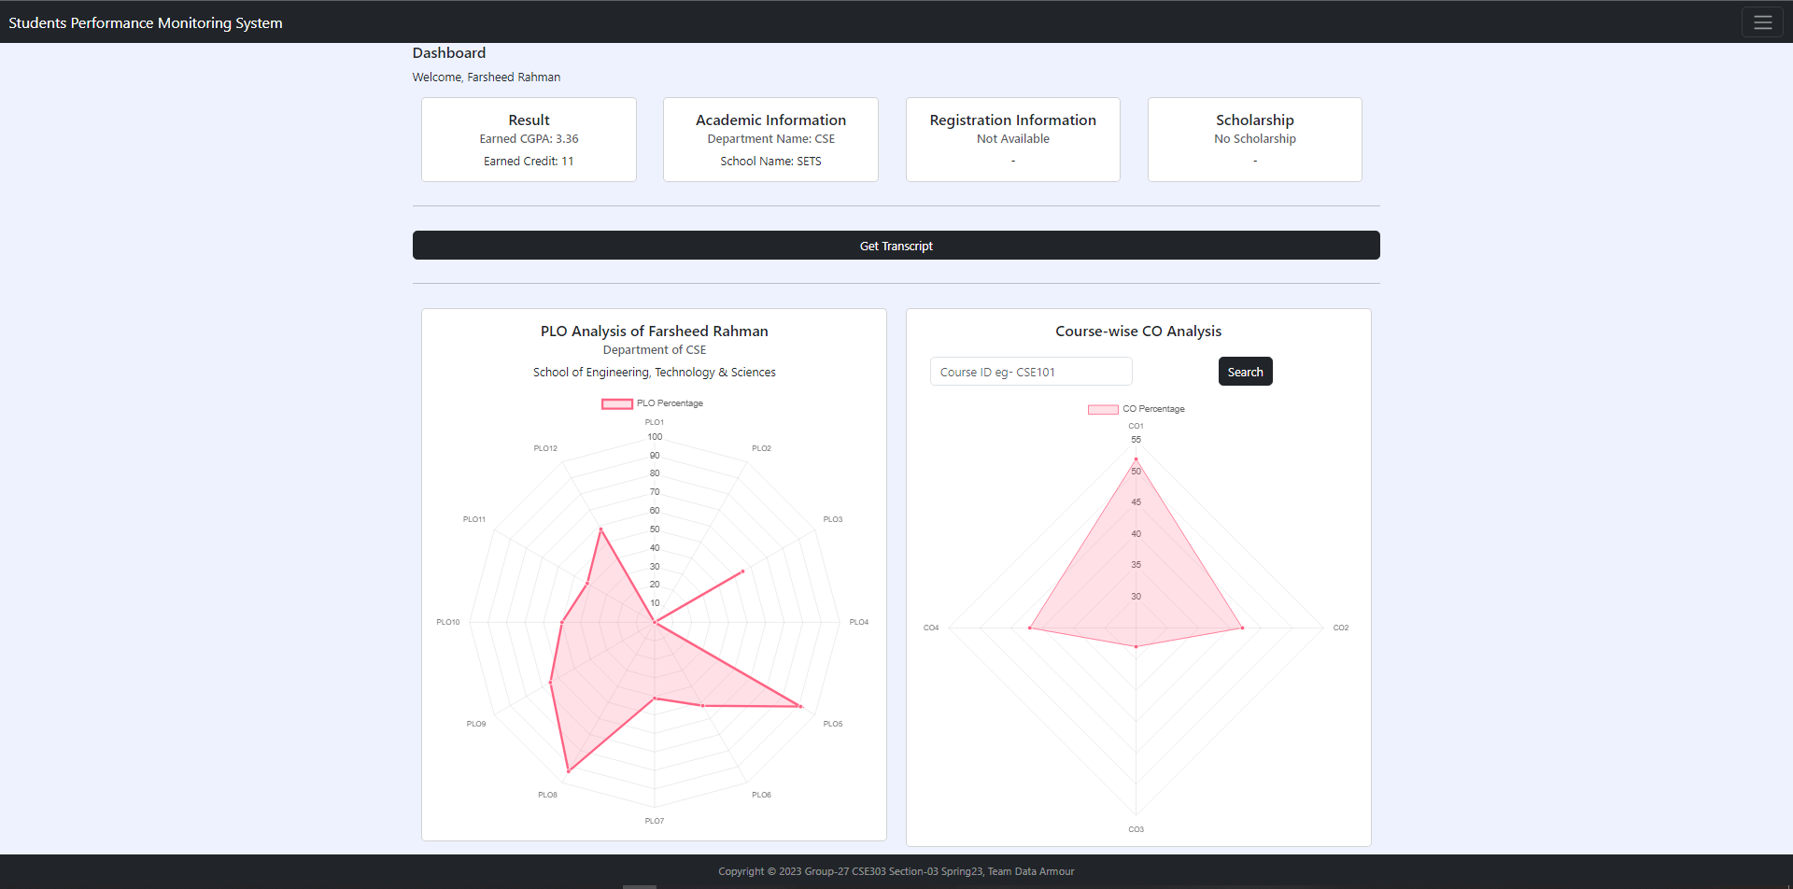
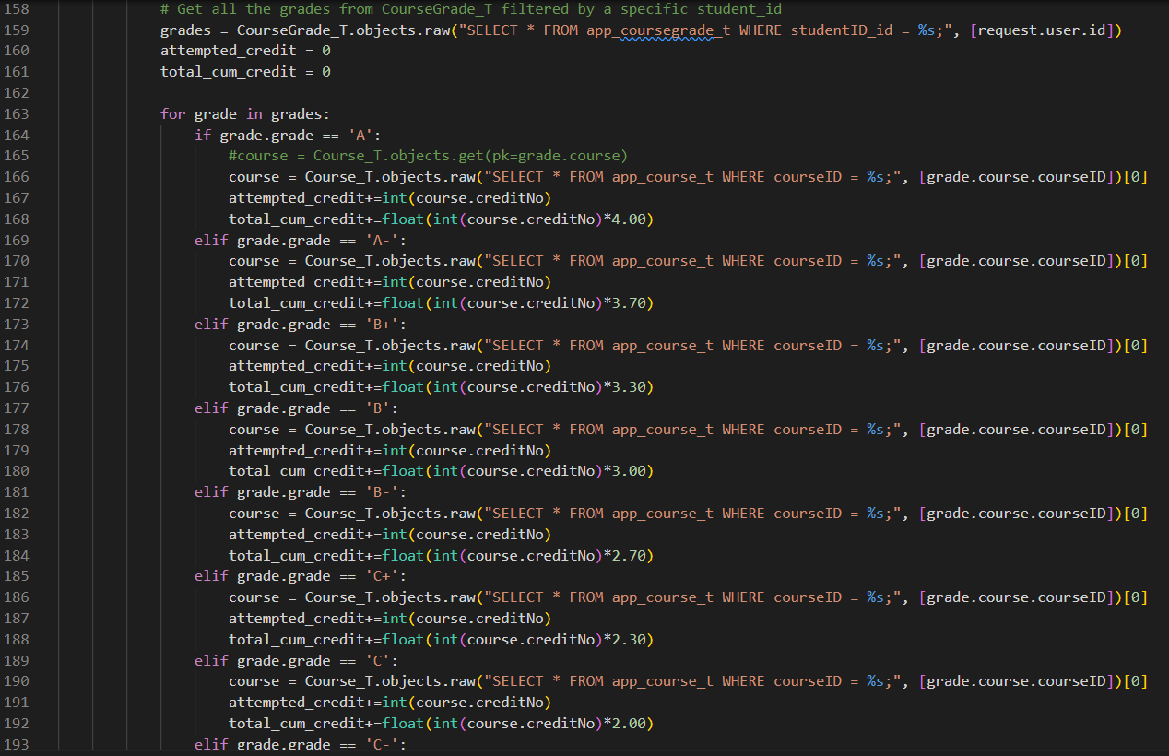
Physical System Design (Student dashboard)

Slide 20
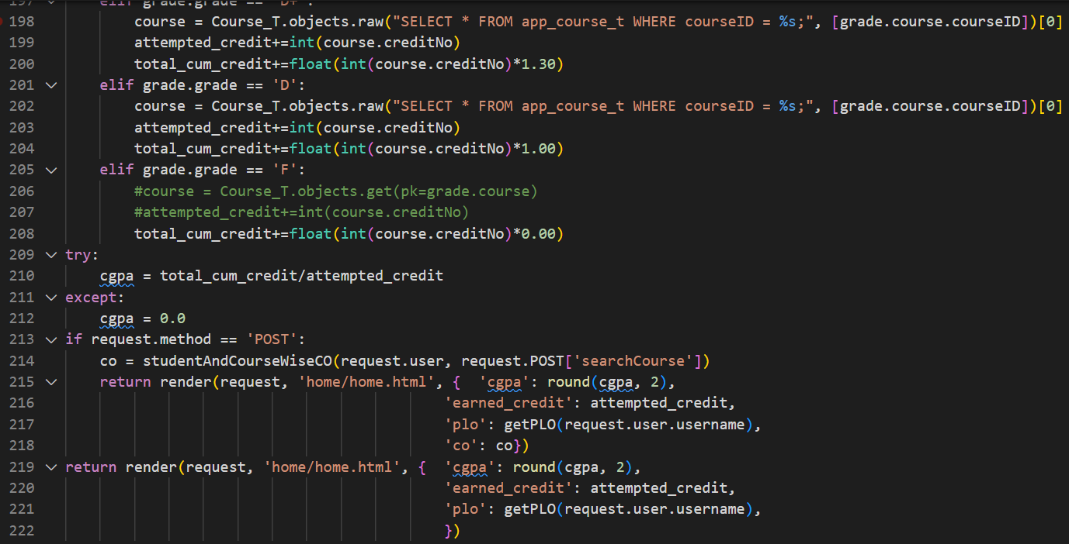
Physical System Design (Student dashboard) Continued

Slide 21
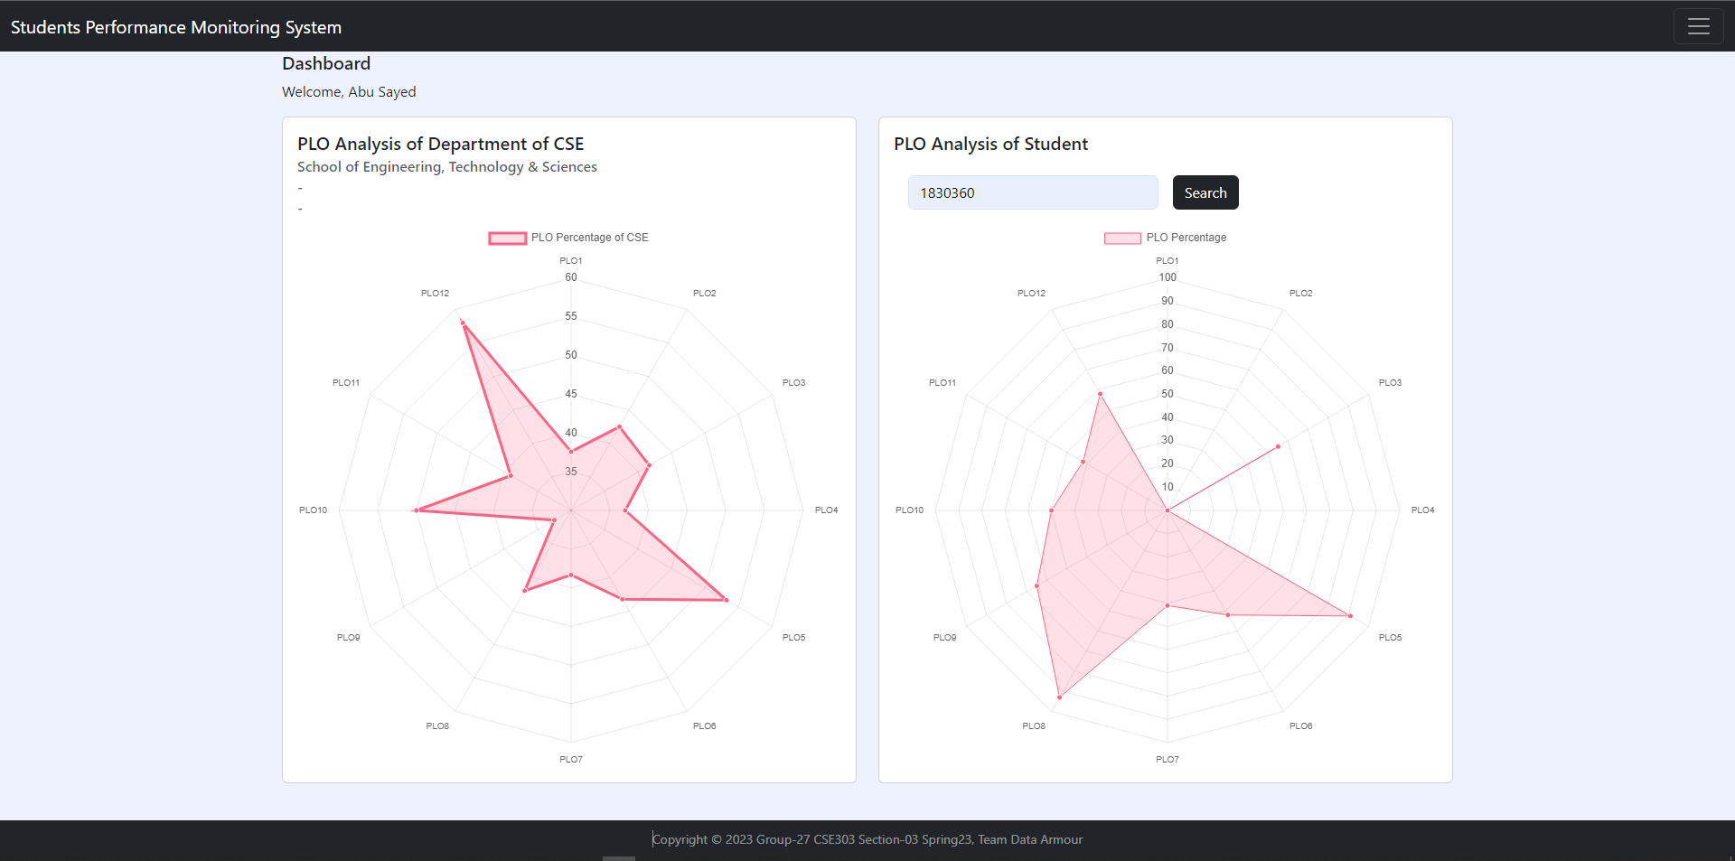
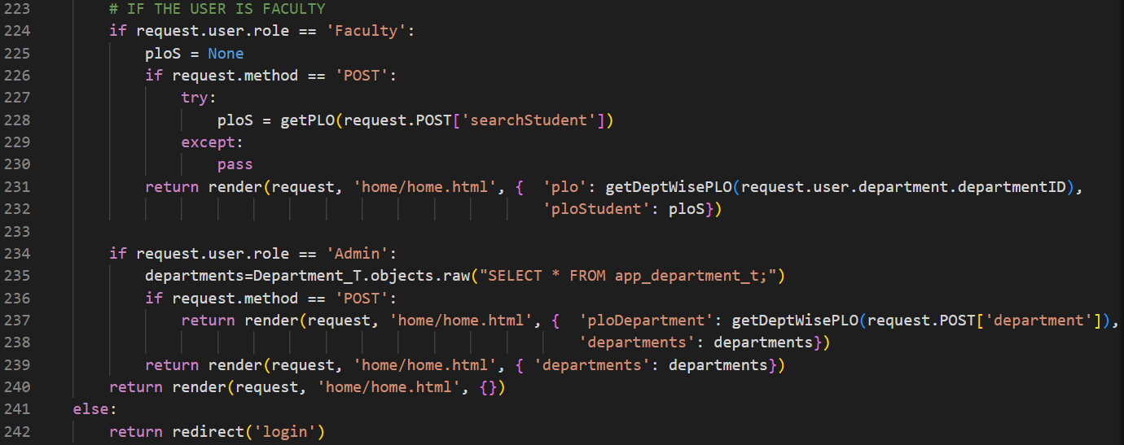
Physical System Design (Faculty dashboard)

Slide 22
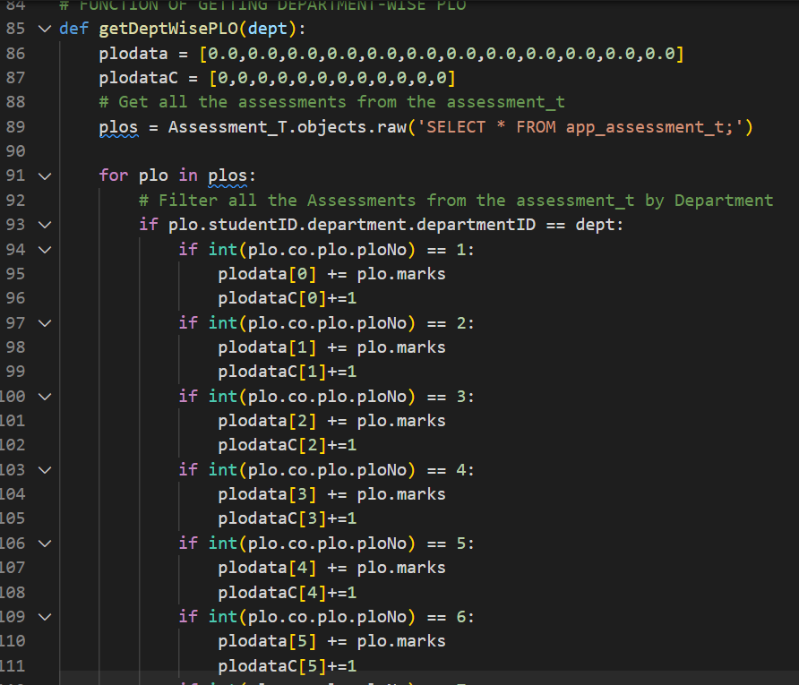
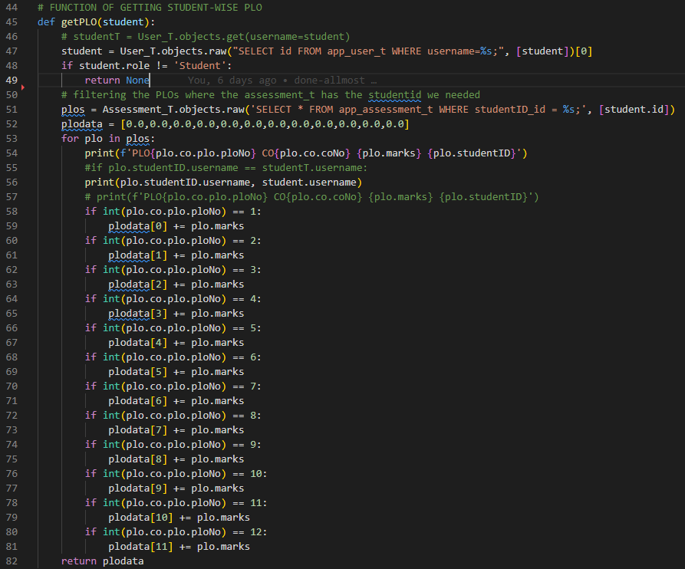
Physical System Design (Faculty dashboard) Continued

Slide 23
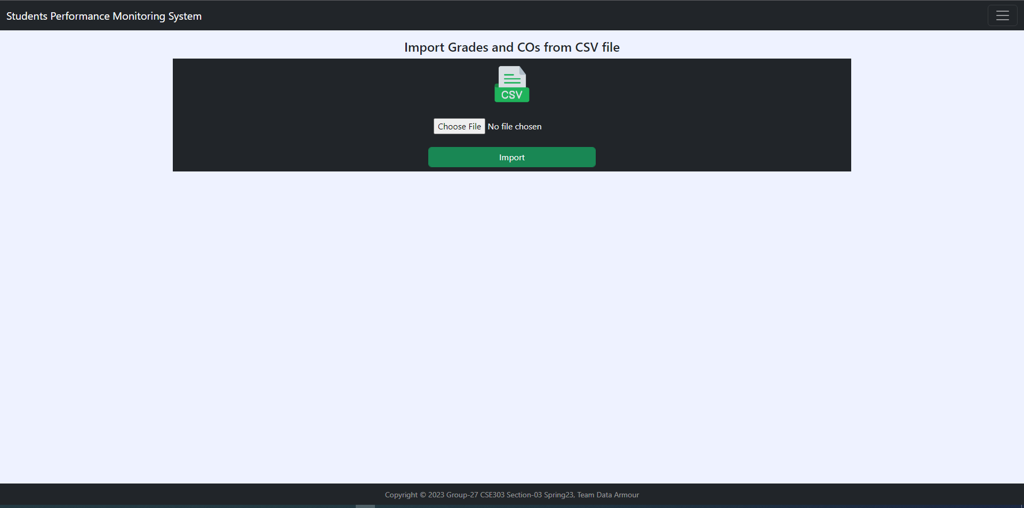
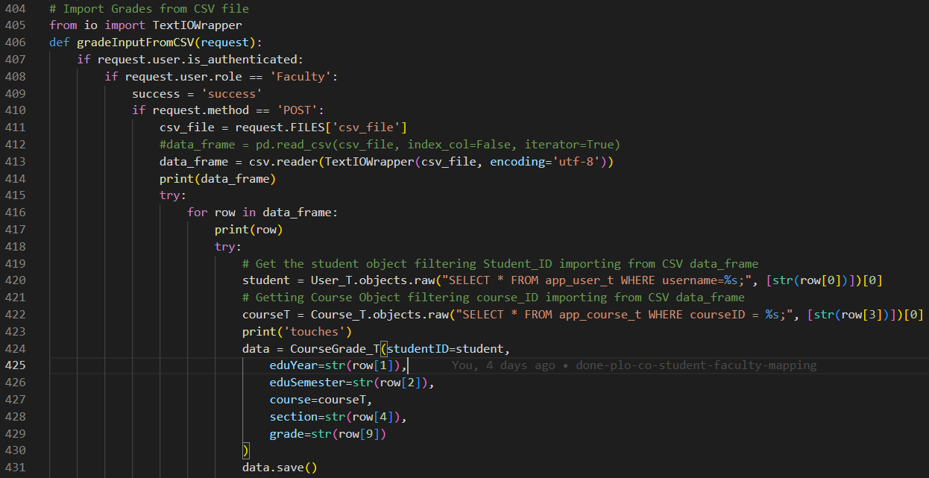
Physical System Design (Faculty CSV import Forms)

Slide 24
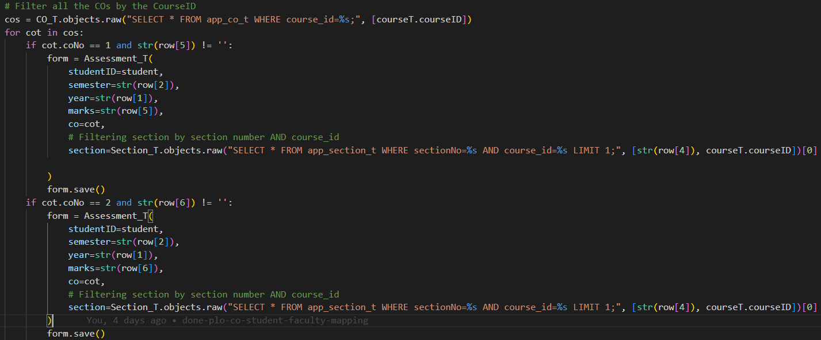
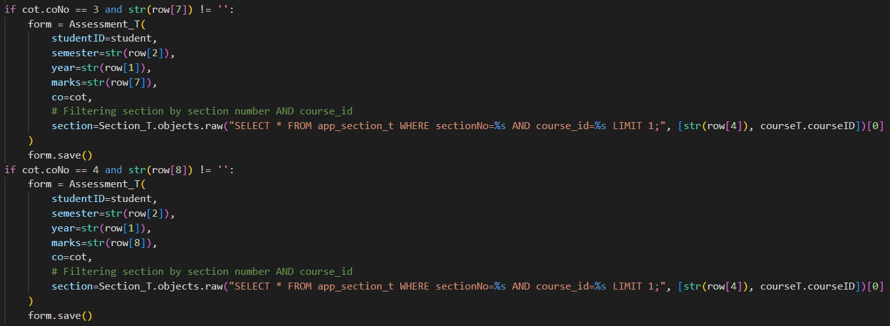
Physical System Design (Faculty CSV import Forms) continued

Slide 25
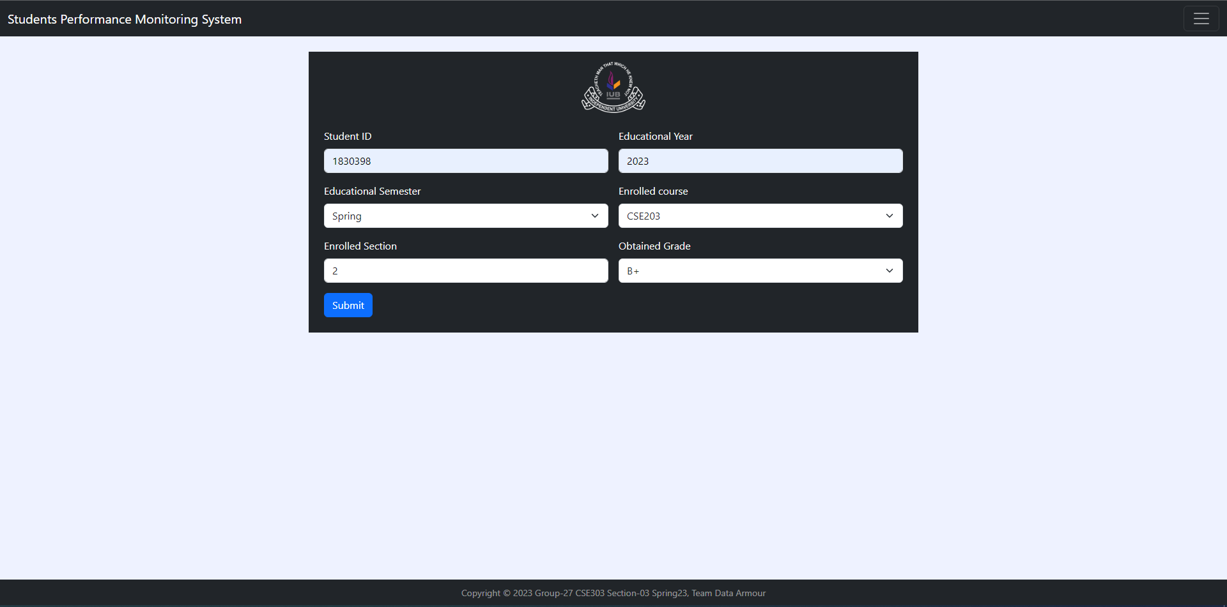
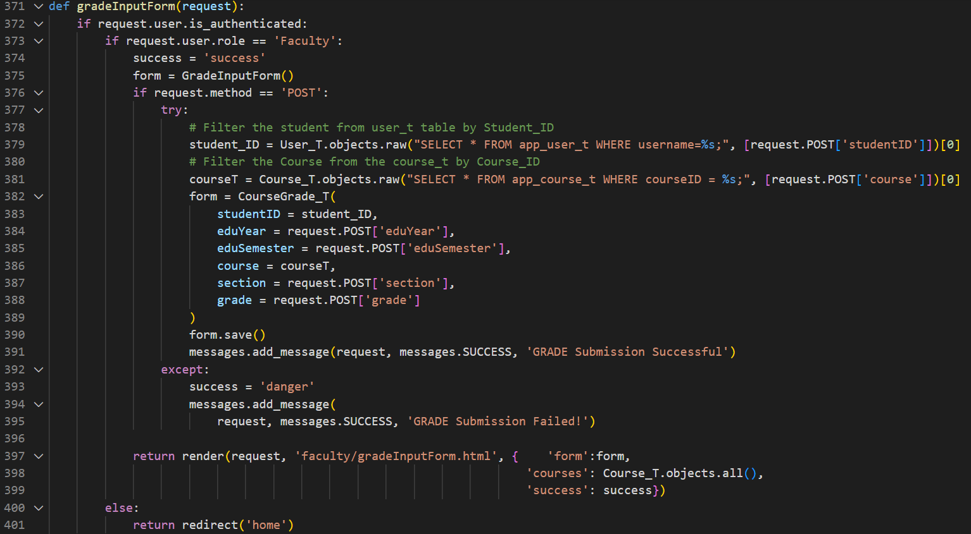
Physical System Design (Faculty Grade input Forms)

Slide 26
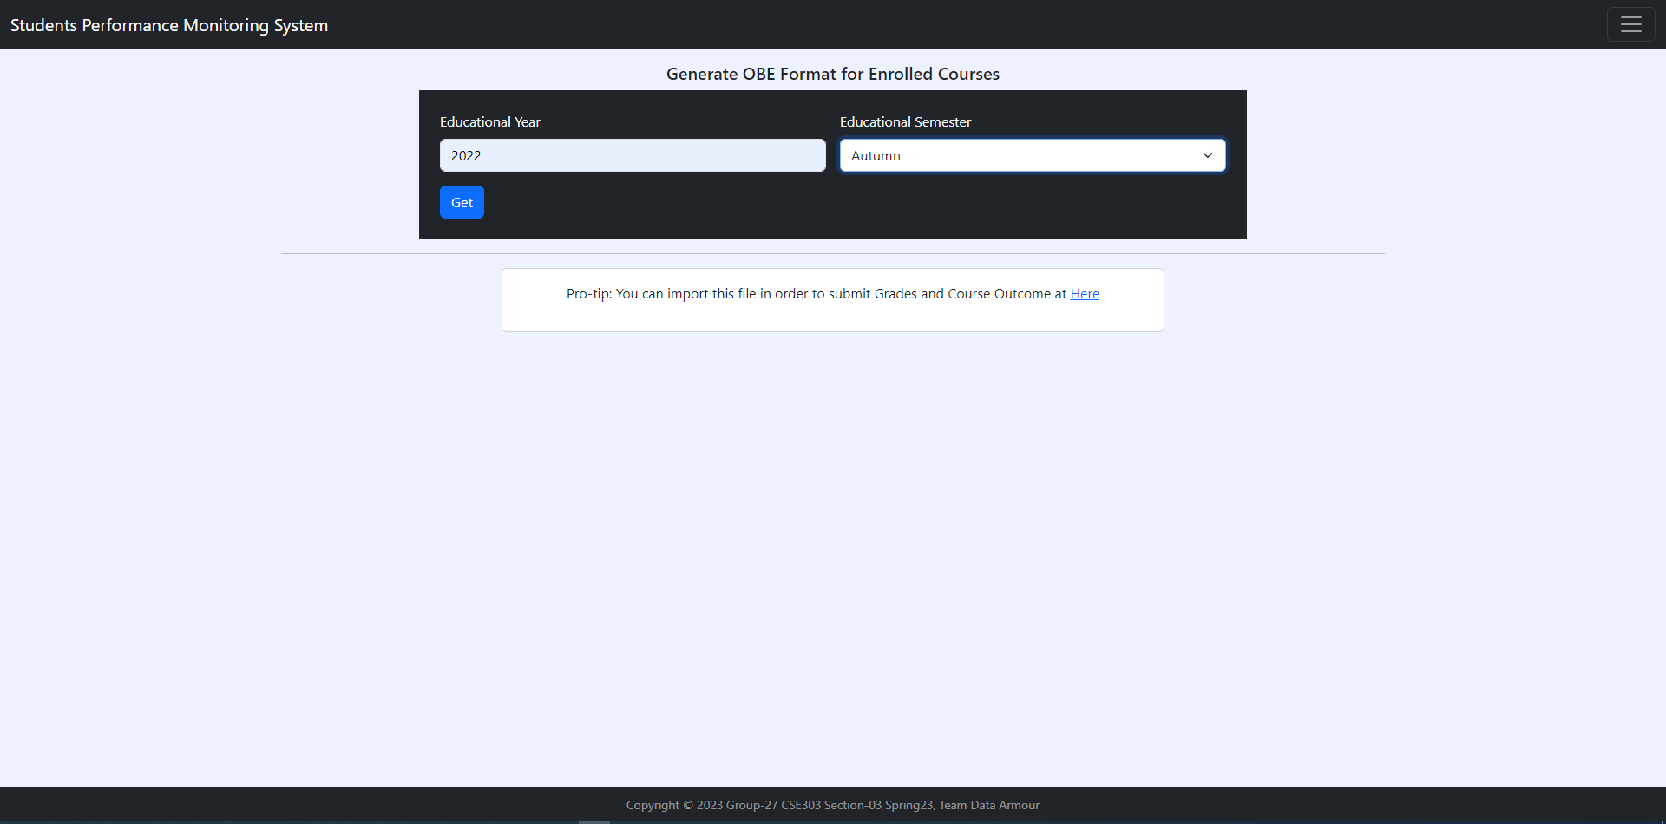
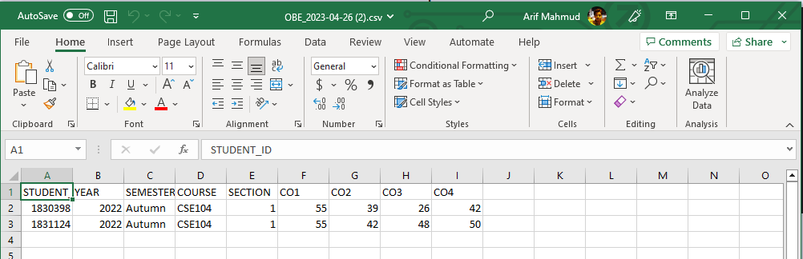
Physical System Design (Faculty OBE Generate Form)

Slide 27
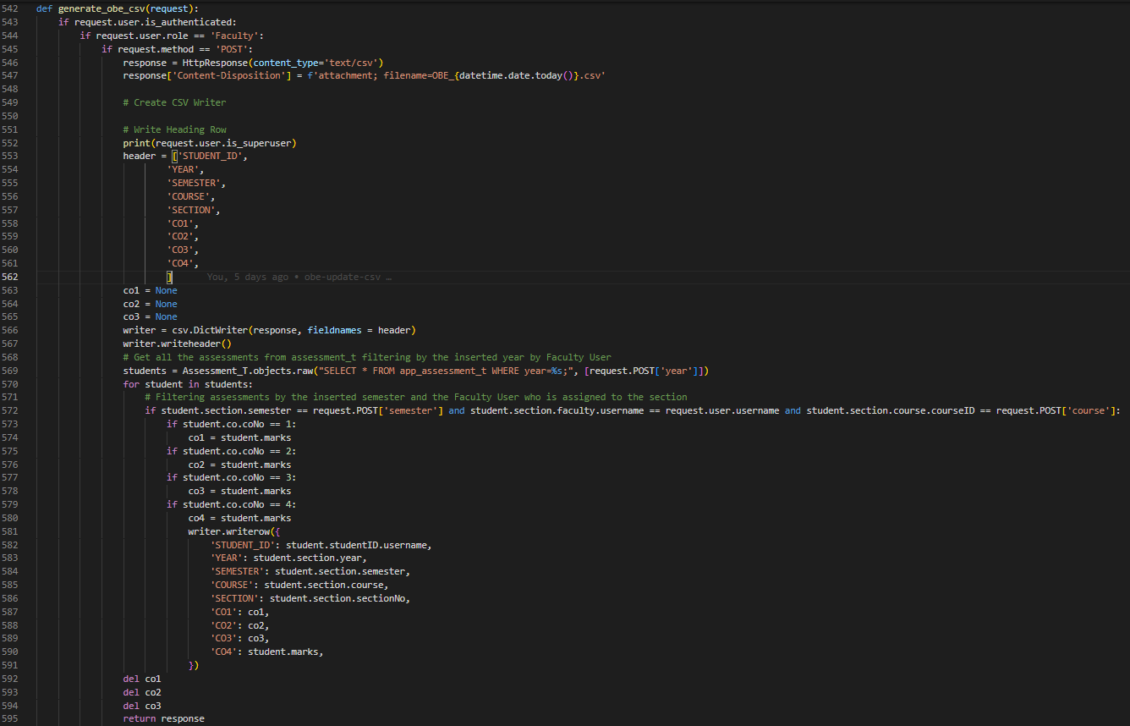
Physical System Design (Faculty OBE Generate Form) Continued [Backend code]

Slide 28
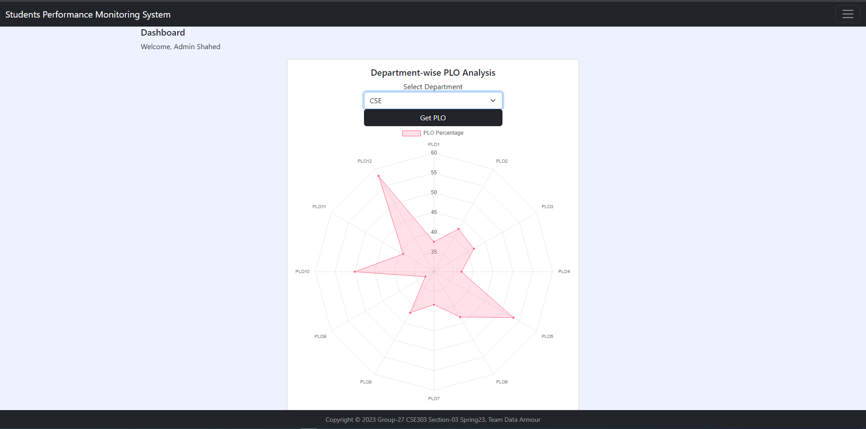
Physical System Design (Admin/Dean Department wise PLO Analysis)

Slide 29
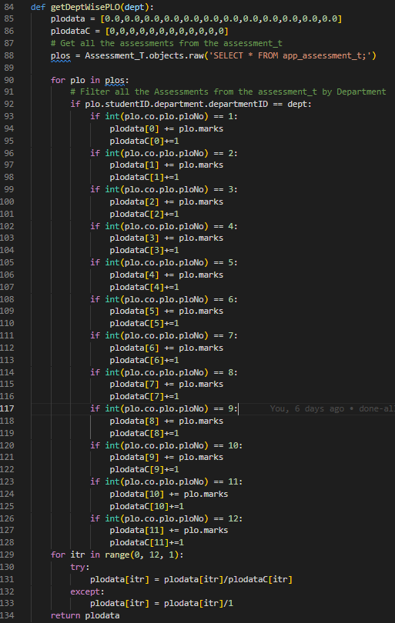
Physical System Design (Admin/Dean Department wise PLO Analysis) Continued [w/Backend code]

Slide 30
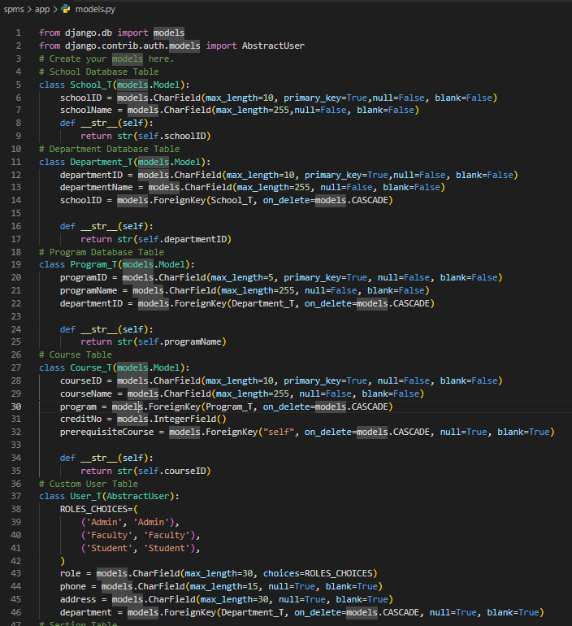
Database Models

Slide 31
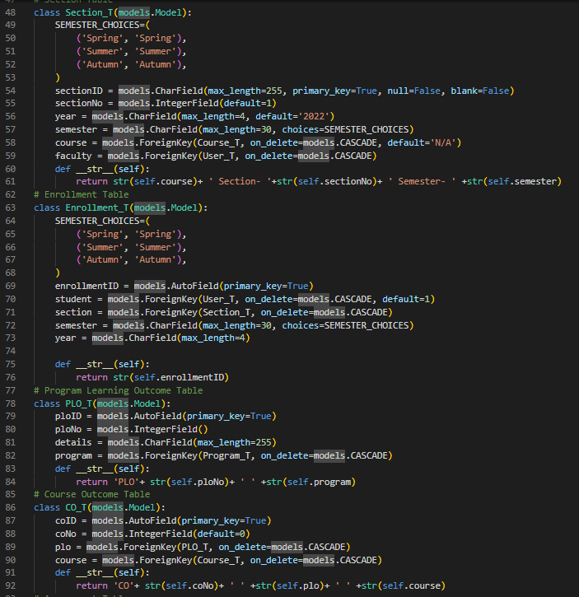
Database Models Continued

Slide 32
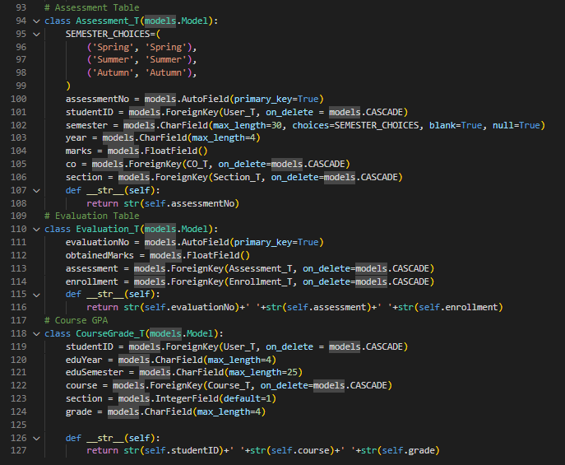
Database Models Continued

Slide 33
Problems And Future Development
Problems:
Our ability to utilize this program to its full potential has been hampered by the limited period of the semester. We intend to make enhancements with greater analysis when given more time, but we believe we have produced the best program we could give the time and resources available.
We might think that we could have produced far more trustworthy and accurate outcomes, representations, and predictions if given more tools and information to work with.
Future Developments:
The number of users will be increased to include advisers, who will receive pertinent data on the students they are advising for better and more advantageous interactions between students and advisors.
Project goals include adding a component that predicts a candidate's grade based on prior grades and performance.
Whenever Faculties will Update a Student’s COs and Grade that student will get Email notifications of updated PLO Analysis
All the Stakeholder’s will have limited access to the System, for example: UGC will have limited access to the system and will have Overview of the Academic’s necessary Incites.

Slide 34
Conclusions
We think the idea we had for our SPM software has been created, built, and implemented in the greatest way possible. With the appropriate application of this software, we intend to significantly raise the standard of education offered by institutions. This program can be used by students who want to become better and more capable scholars, by faculties to keep better track of their students and adjust their teaching strategies accordingly, and by institution members to more effectively manage their resources

Slide 35
Thank You!

